Slide 1
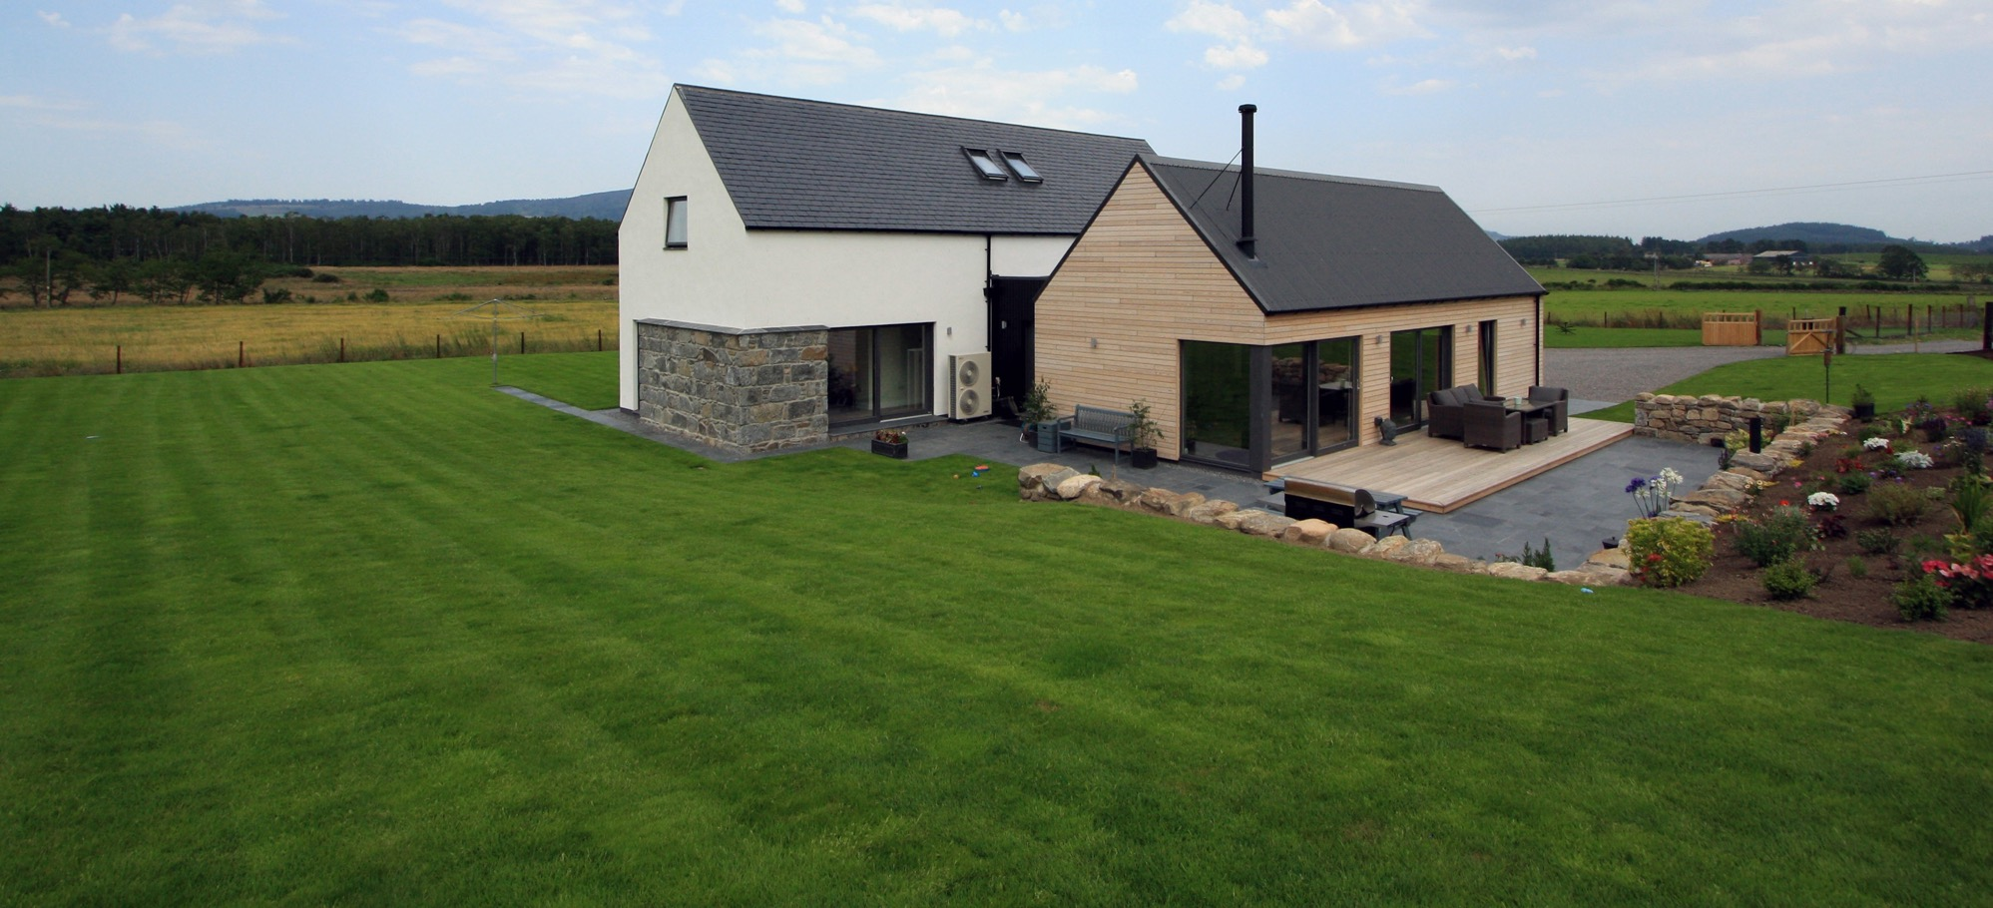
HOW CAN SELFBUILD AND CUSTOM BUILD AUGMENT OUR HOUSING NEEDS
Tom McSherry
National Relationship Manager & Self Builder

Slide 2
www.buildstore.co.uk
AGENDA
Market Overview
Design, Construction & Impact on Finance Options
Risk Mitigation & Processes
Solution Based Products
Other Opportunities
Why BuildStore?

Slide 3
www.buildstore.co.uk
MARKET OVERVIEW
2019 A LANDMARK YEAR
47,000 people registering their desire to self or custom build on Right to Build Registers. This will only grow.
LOCAL AUTHORITIES
Local authorities are starting to build serviced plots into their planning - even larger builders are now having to release land from their site plans.
“The time has never been better for anyone wanting an owner-commissioned home, with the Right to Build ensuring that is supported legislatively and on an individual council level. What’s more, there are more finance companies and products servicing the market, and more companies operating in the field.”
National Custom & Self Build Association (NaCSBA)

Slide 4
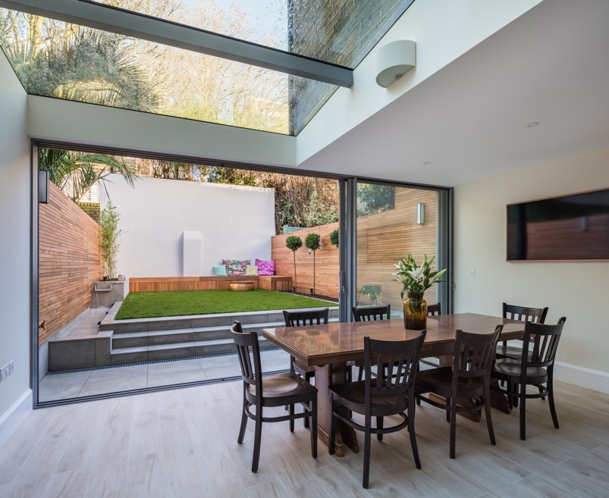
www.buildstore.co.uk
MARKET OVERVIEW
Help to Build Equity Loan Scheme
To address the imbalance by the Help to Buy scheme, which custom and self builders have been unable to access.
“We will support community housing by helping people who want to build their own homes find plots of land and access the Help to Buy scheme.”
Conservative Manifesto, Community Housing and Self Build
Image courtesy of Studio 30 Architects

Slide 5
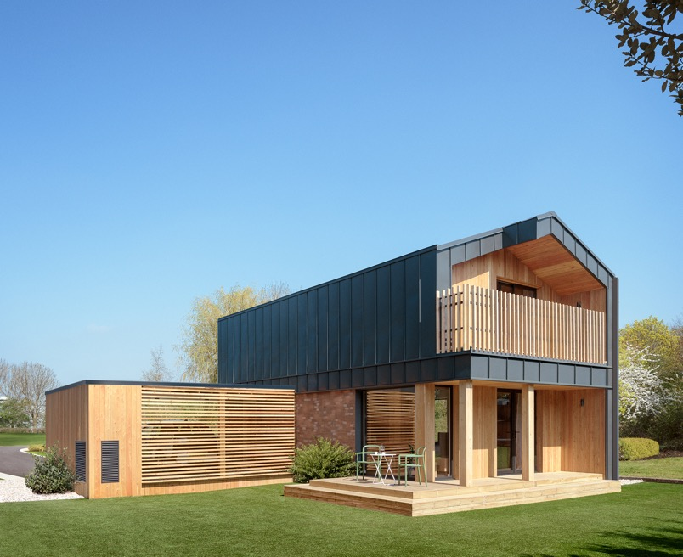
www.buildstore.co.uk
DESIGN, CONSTRUCTION & IMPACT ON FINANCE OPTIONS
Be aware of the external pallet and how this can effect lenders- check with us if unsure. Make sure your client can afford to include these elements.
Zinc, steel, sedum roofs, flat roofs
Lightweight render
Timber cladding
Verify your client’s budget/project costings to make sure they work – that’s where we can help!
Don’t restrict your clients funding options. Establish a clear budget at outset with BuildStore.
Image courtesy of NHouse

Slide 6
www.buildstore.co.uk
RISK MITIGATION & PROCESSES
Setting and verifying your client’s budget
Ensuring sufficient contingency
Higher lending percentages – up to 95% of land and up to 95% of build costs
Cost based stage payments
Advance Stage Payments
Responsible build costs (costing evaluation) - £/sq m
Tailored Cash flow
If the right funds aren’t available at the right stages of the build delays are inevitable and often expensive

Slide 7
www.buildstore.co.uk
SOLUTION BASED PRODUCTS
If your clients only have a small amount of cash available, don’t want to sell their existing house to release equity before their new one is complete, want to keep cash as contingency or simply want the assurances of positive cash flow throughout their project – our advance stage payment mortgages are ideal.
Clients can pay for their suppliers and trade teams whenever they want paid, at milestone stages of the build - perfect to meet off-site manufacturing terms.
Clients can stay in their own home as they build their new one.
Clients become cash buyers of materials and as a result won’t need to create merchants accounts so can negotiate better terms.
Higher lending percentages - up to 95% on land and up to 95% on build costs in advance. Stage releases not determined by interim valuations.
DAILY
WEEKLY
MONTHLY

Slide 8
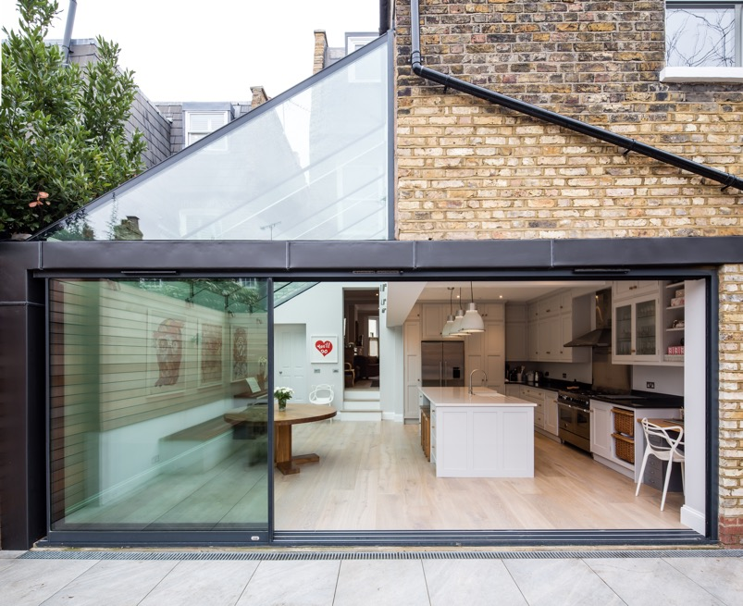
www.buildstore.co.uk
OTHER OPPORTUNITIES EXTENSIONS & HOME IMPROVEMENTS
With BuildStore, your client’s project is not limited to the current value of the property and can borrow up to 85% of the end value of the completed project which might be 100% of the build costs.
Opening doors to many more potential customers who think they can’t afford to extend
Image courtesy of Peter Morris Architects

Slide 9
www.buildstore.co.uk
EXTENSIONS & HOME IMPROVEMENTS
HIGH STREET OPTION
HOME IMPROVEMENT & RENOVATION MORTGAGE
Current Property Value
£200,000
Current Property Value
£200,000
Current Mortgage Balance
£170,000
Current Mortgage Balance
£170,000
New 95% mortgage
£190,000
95% of current value
£190,000
Funds available
£20,000
Additional Funds
£30,000 in advance
Build Costs
£50,000
New Loan Facility
£220,000 80% of New LTV
Shortfall
£30,000
New Property End Value
£275,000

Slide 10
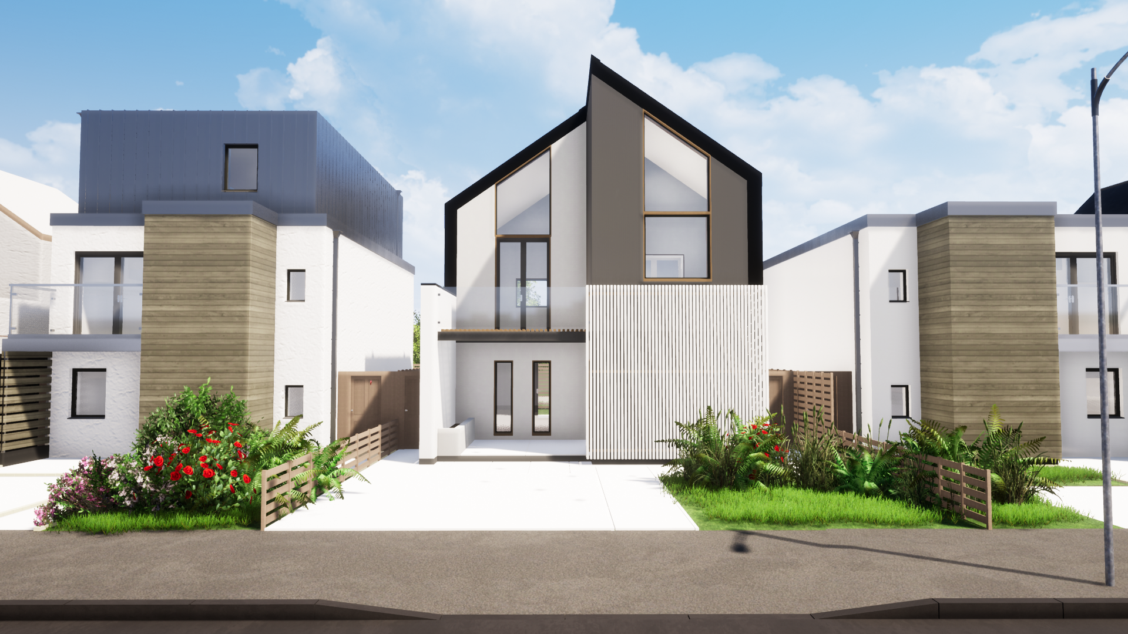
www.buildstore.co.uk
CUSTOM BUILD
Multiple Plots
Complexity
Lender Briefs
Lender Saturation Levels
BuildStore can support you on custom build sites with innovative mortgage products and unbeatable know-how.

Slide 11
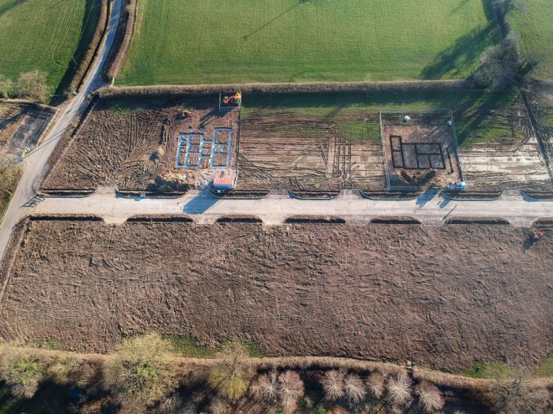
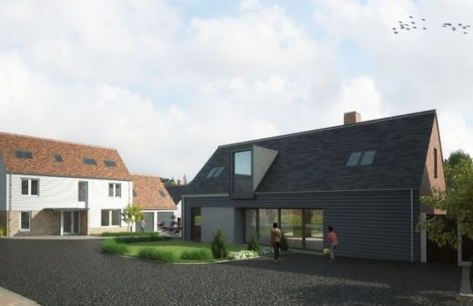
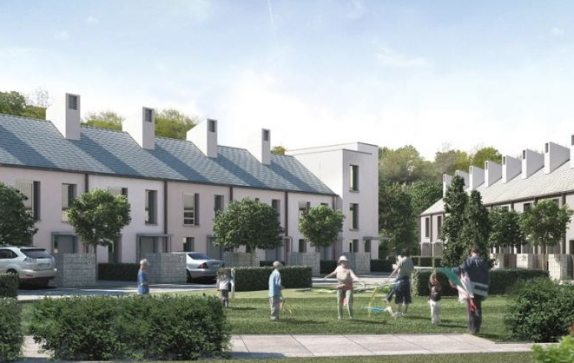
www.buildstore.co.uk
CUSTOM BUILD
We’ve seen around a 20% increase in individual self build plots, but more and more multiple plot developments as the government encourages a new breed of enabling developer.
SERVICED PLOTS
Parcelled building plots sold with planning permission agreed, road access in place and all required utilities serviced to the boundary.
CUSTOMISABLE HOMES
Newly constructed homes offering buyers the opportunity to configure internal living spaces and fit out the interior.
COLLECTIVE CUSTOM BUILD
Individuals come together as a group to collectively develop new homes to their preferred designs for themselves and others.

Slide 12
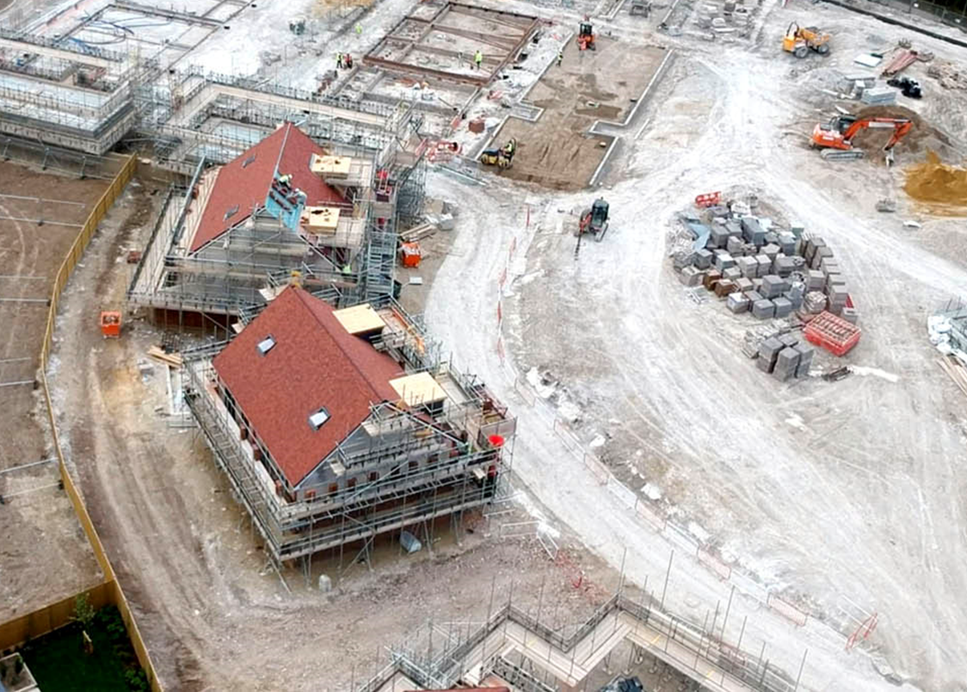
www.buildstore.co.uk
CUSTOM BUILD
New breed of enabling developer
Creates individual serviced plots
Puts in the infrastructure, roads, drains and utilities up to the boundaries
Secures planning permission
Who can deliver these?
Housing associations
Local authorities
SMEs
SHOVEL READY PLOTS
ready to build on!

Slide 13
SPECIALIST
Knowledge & expertise
WHY CHOOSE BUILDSTORE?
EXCLUSIVE
Mortgages & lenders
COMPETITIVE
Interest rates
INTEREST ONLY PAYMENTS
During the build
GUARANTEED
Upfront stage payments available
TAILORED CASHFLOW
To suit clients payment schedule

Slide 14
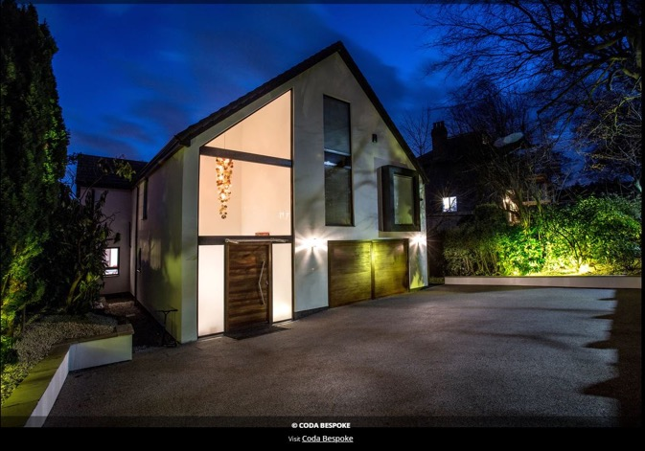
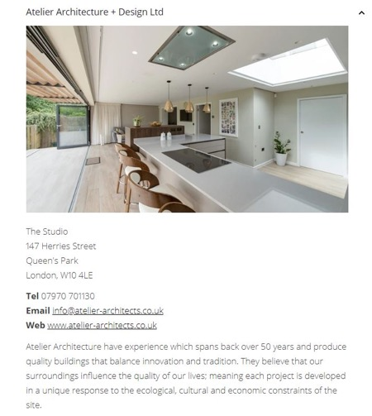
www.buildstore.co.uk
FINALLY…
BuildPartner Directory Promote your business free of charge
BuildStore Gallery & Social Media Promote your designs free of charge with a link to your own website
How to get in touch…
T +44(0)345 223 4888
E enquiries@buildstore.co.uk
W www.buildstore.co.uk
Image courtesy of Coda Bespoke
Image courtesy of Atelier Architecture & Design Ltd

