Slide 1
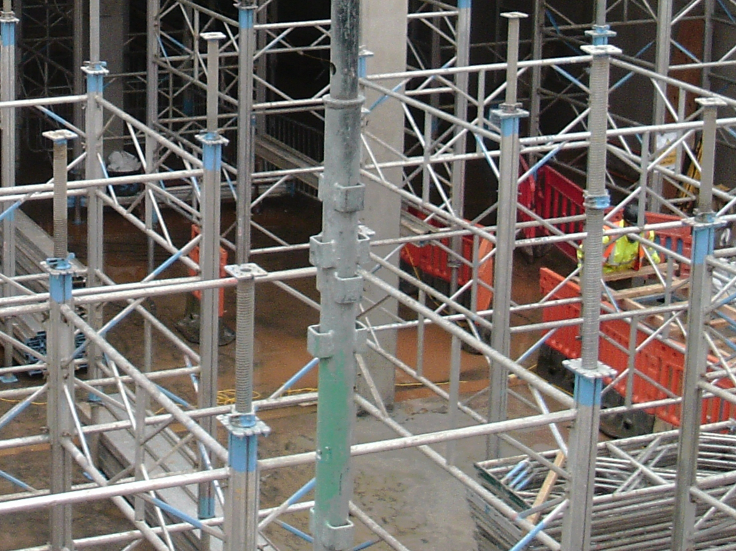
Panel Discussion
18th December 2020

Slide 2
Current Situation
We have a burning platform!
Currently we have approximately 230k Construction workers in the southwest
CITB noted that we needed 27k new workers needed in the Southwest between 2020 and 2023 (taking us to over 250k construction workers in Southwest)
In the Southwest 27% of people in workforce between ages of 45 & 65
BUT … In construction industry this is 47%!
AND .. 20% of construction workforce are over 55!
Diversity - 13% of workforce are female
Just 3% of site operatives female

Slide 3
Current Situation (Cont.)
UK average is that 6.5% of construction workforce retires each year when over age of 50
Construction retirement ages
22% retire between 50 & 55
43% retire between 56 & 60
35% retire between 61& 65
So what??
When we add retiring workforce in simple terms we add circa 50% to our requirement
So we need more like 40k workers between 2020 and 2023!!

Slide 4
SALARIES IN CONSTRUCTION(2019 – 2020 IGNORED – COVID)
Construction 2nd best paying sector after Finance and building services
National Average wage in UK 2019 = £578 / Week
Finance and Business services = £801 / Wk
Construction = £669 / Wk (£91 above uk average) or c£5k per annum
So if wages are good why have we got such a challenge to get young people into the industry?

Slide 5
The Focus for the next year
G4C
Relaunching G4C in earnest in January 21
Need to significantly enhance G4C membership and output
New G4C chair (member of CE board) – Lisa Denby – Kier Construction & Vice chair Josh Hodder of Highways England
We need members!! Please can you promote G4C within your organization our website is being updated as we speak which will have all the details you need this will go live in January
A piece of work to be undertaken alongside with G4C feeding into situational review by a 3rd Party in terms of what we need to do to “future proof” sector, increase engagement and advise on best way to engage young people and bring people into our industry

Slide 6
In Summary
We have a burning platform!
We have a need to increase the number in construction dramatically in the South West
But salary levels are very good!
We need to get young people into our great industry
Breathe new life into G4C, empower and support the new team – this will be my key focus for 2021 (I’m all Brexit and Covid out!!)
Anyone with talented young staff please get them involved in G4C – it is all on line and won’t take up too much time
Once complete in H1 21 we will present the findings as part of an online session and update everyone on progress of our G4C drive

