Slide 1
COP26: the wood construction sector sets out its stall at the UN climate change talks in Glasgow,
November 2021
Paul Brannen Director Public Affairs CEI-Bois & EOS Former MEP

Slide 2
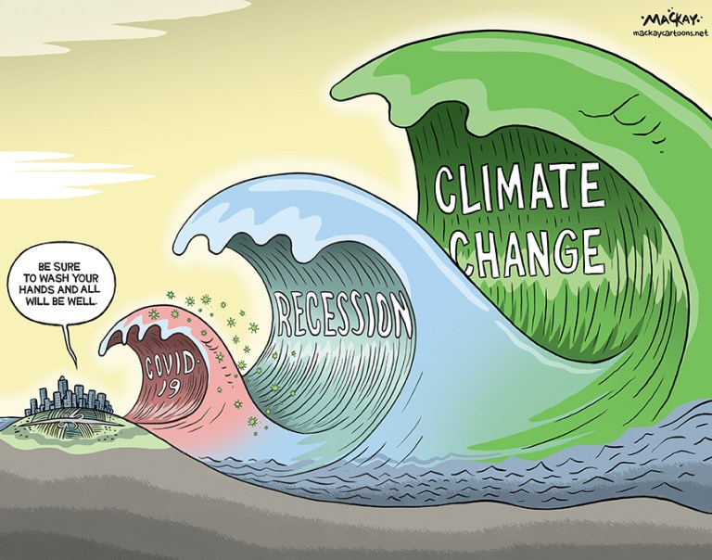

Slide 4
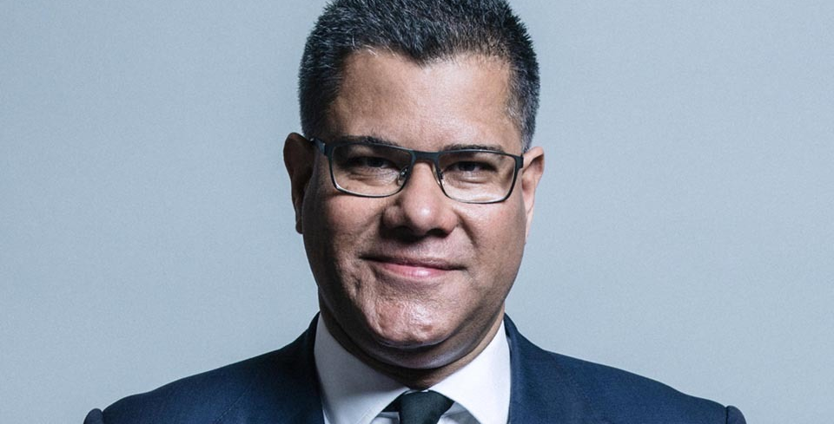
Notes:
Alok Sharma MP President of the COP, sits in full cabinet

Slide 5
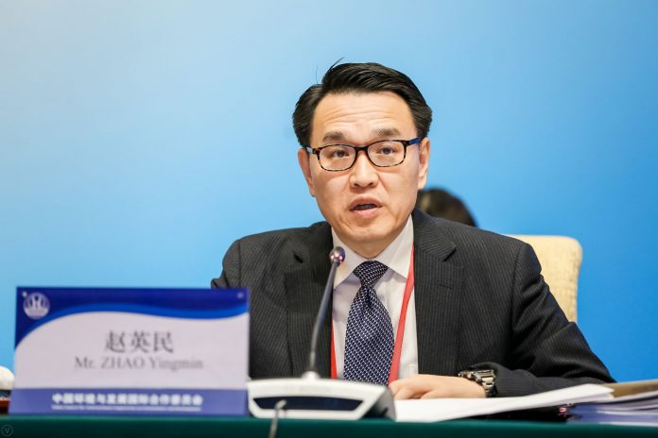
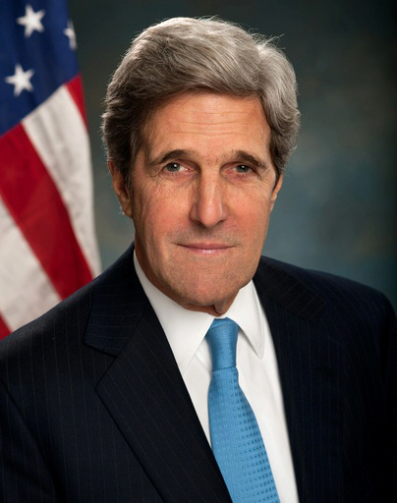
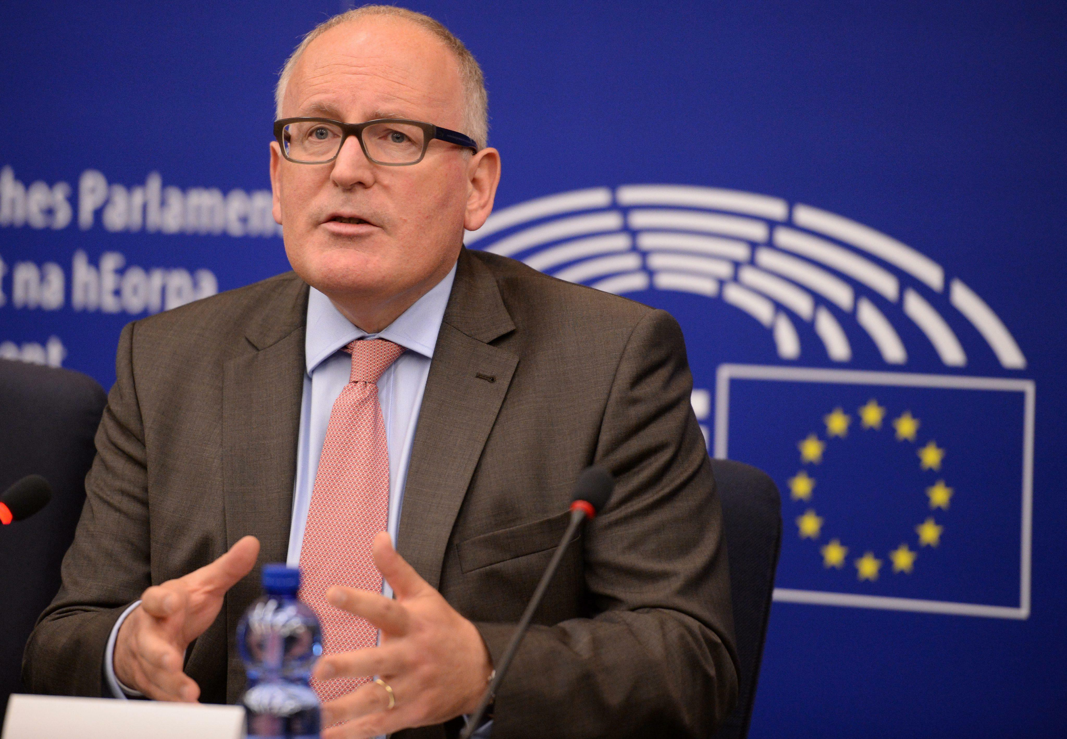
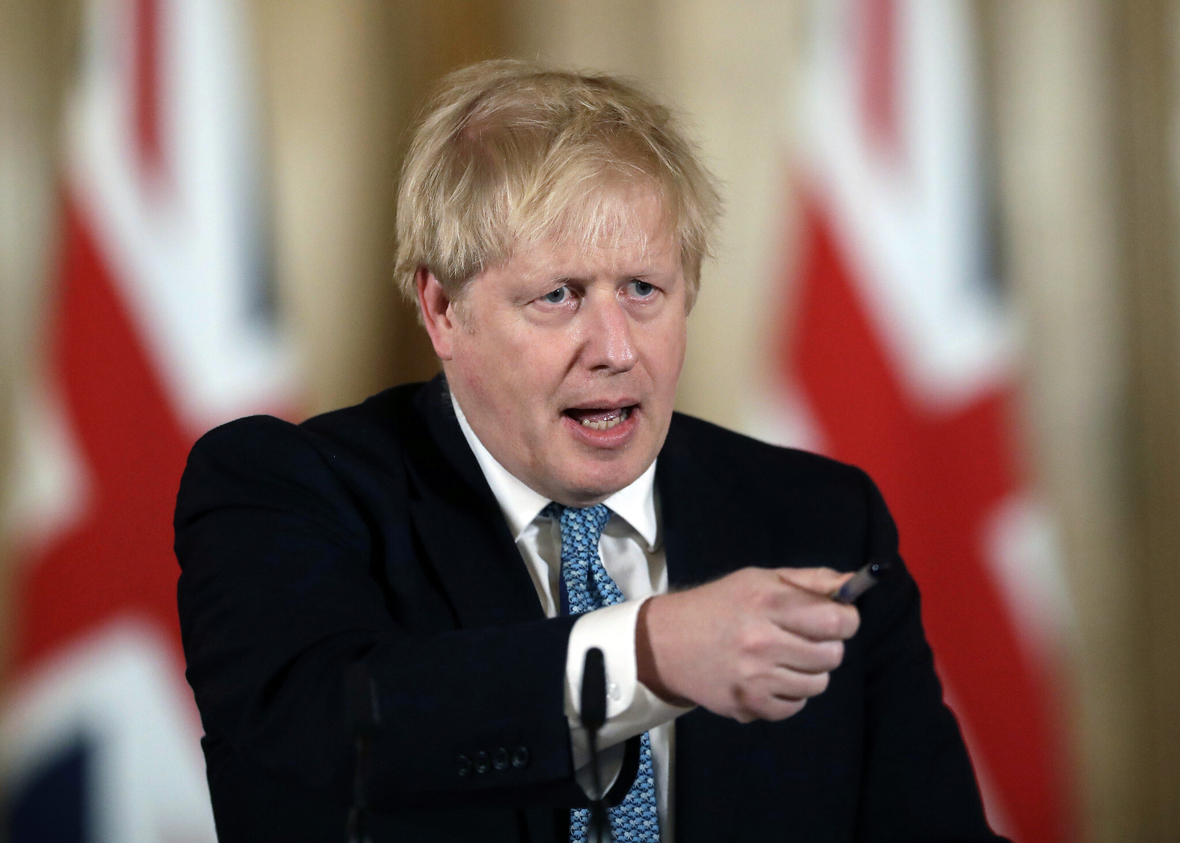
Notes:
China’s top climate negotiator, Zhao Yingmin, may insist that climate change requires mutual collaboration and commitment
How many socialists can you see?
Special soft ware that sizes the photograph according to the importance of the person !
A republican can see 3 … a Trump loyalist probably sees 4 !

Slide 6
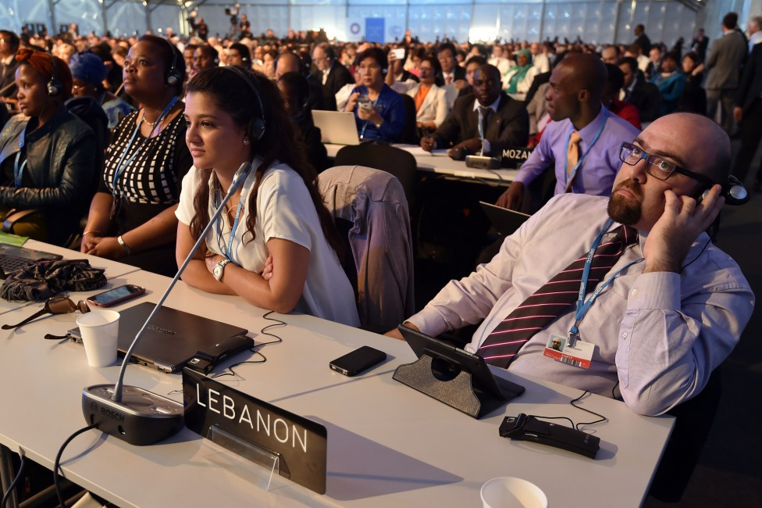
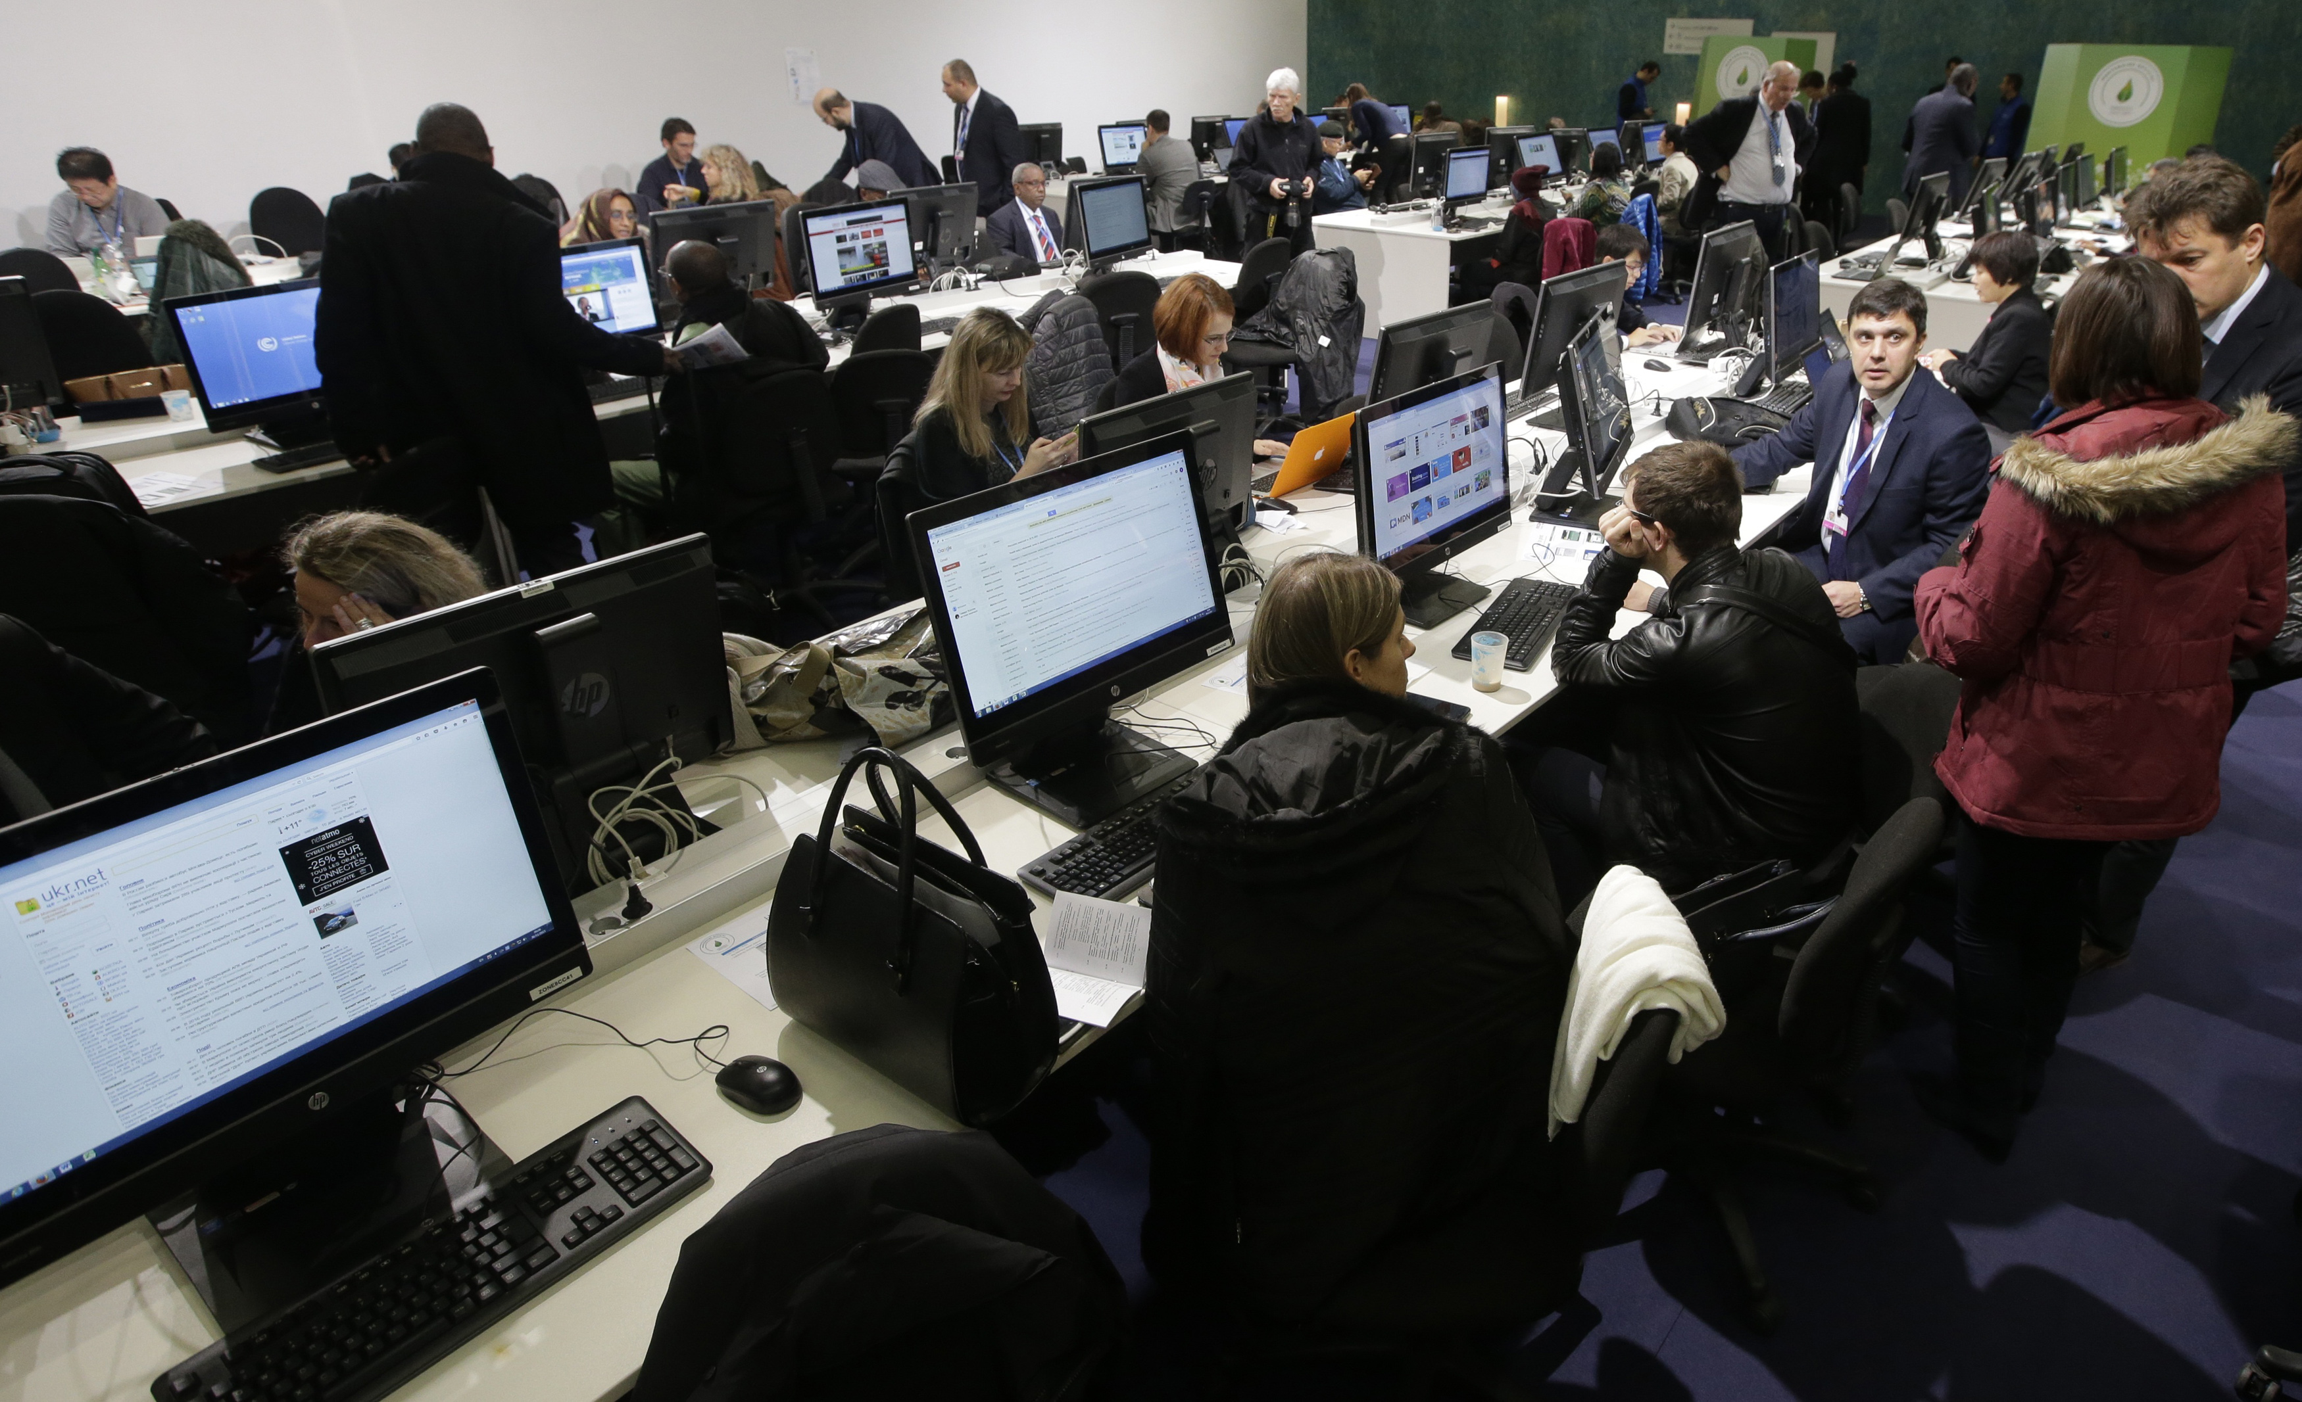
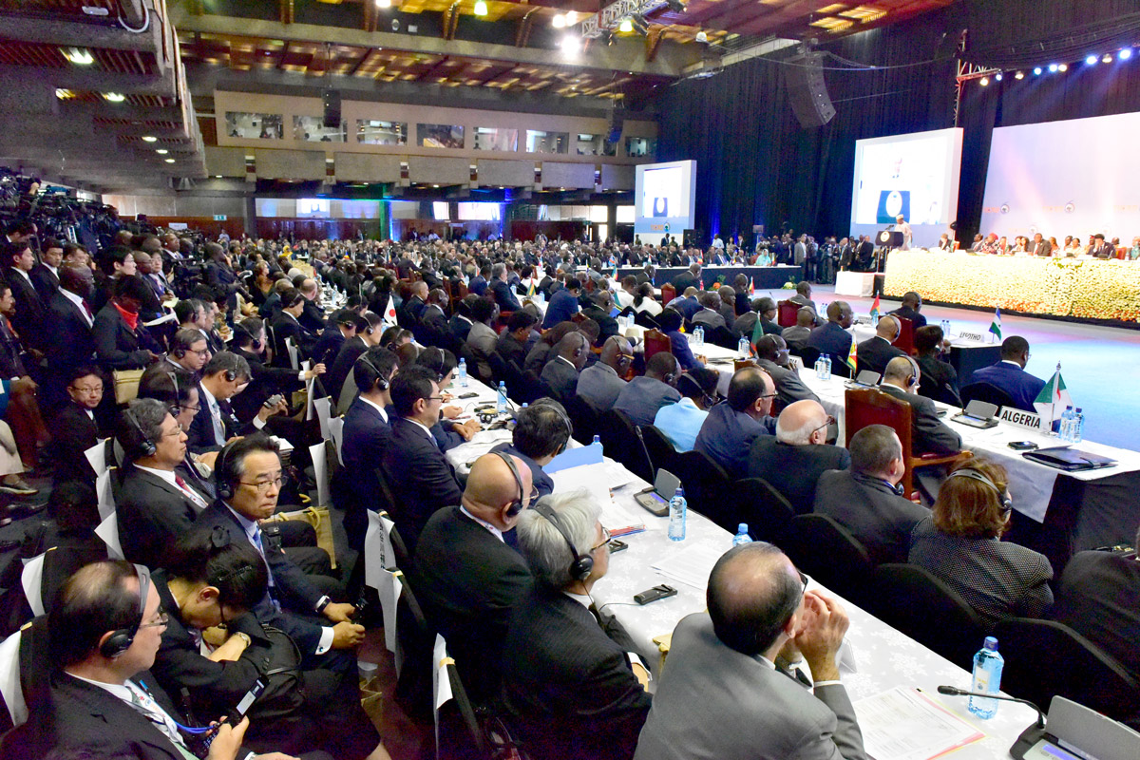
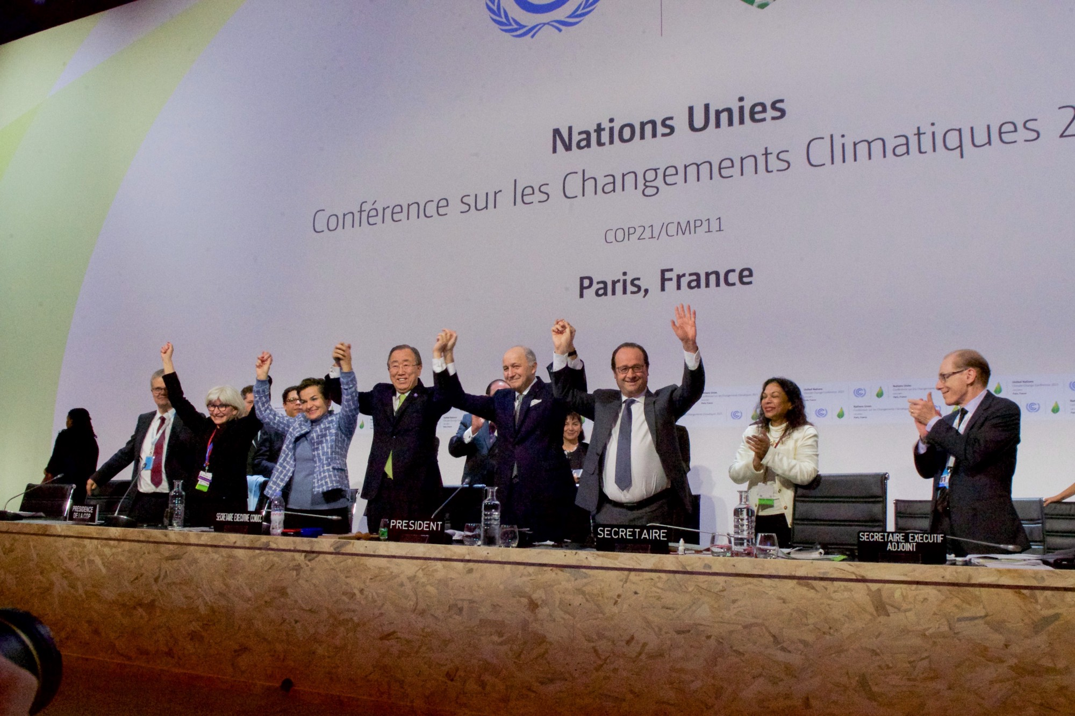
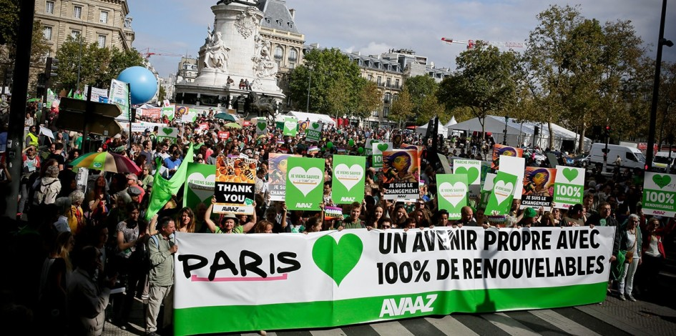
Notes:
Paris COP 2015

Slide 7
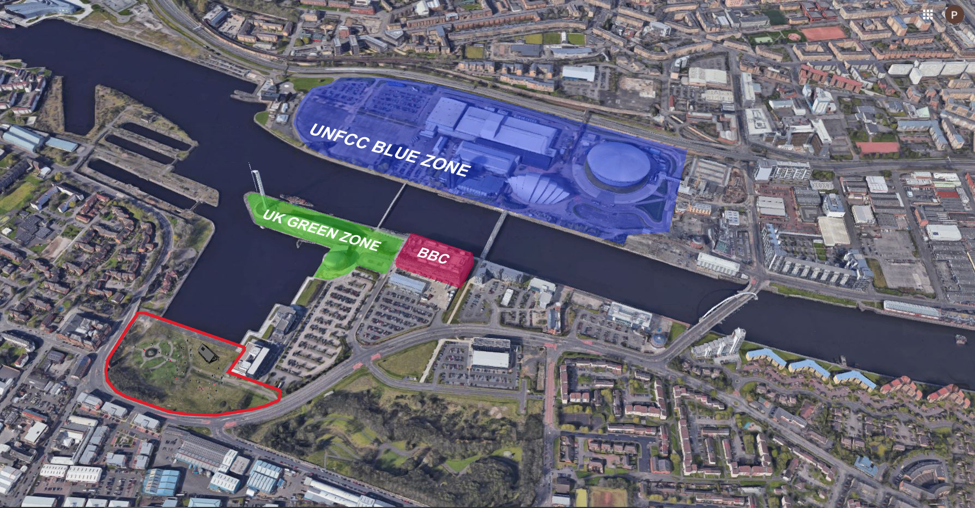

Slide 8
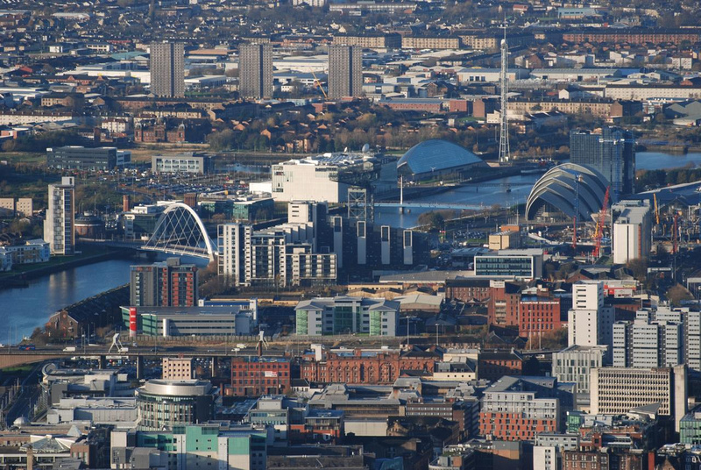

Slide 9
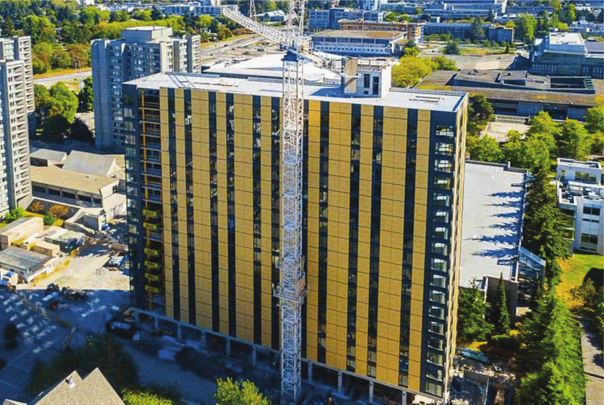
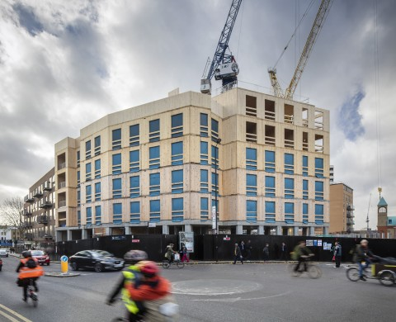
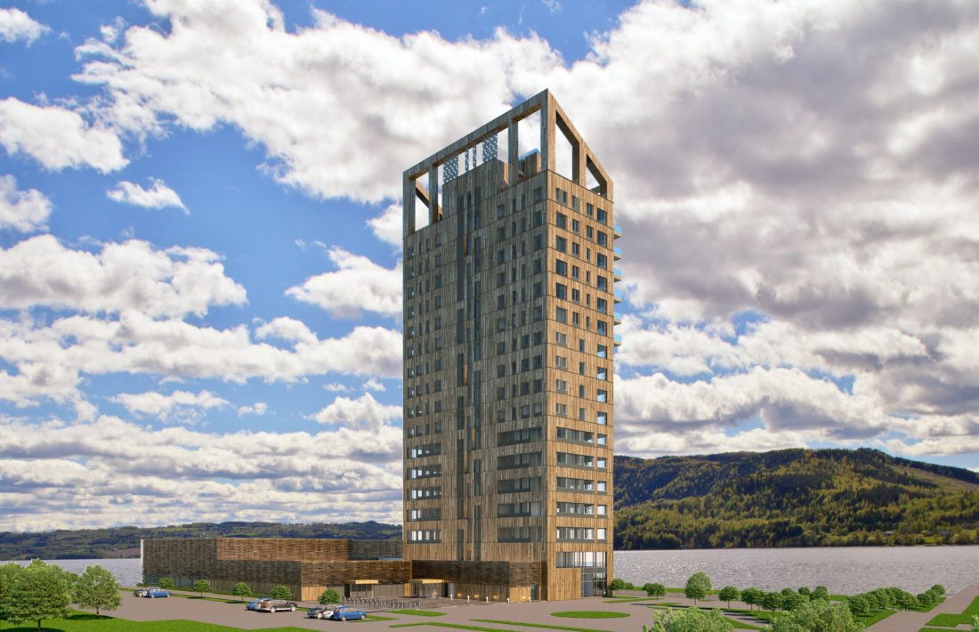
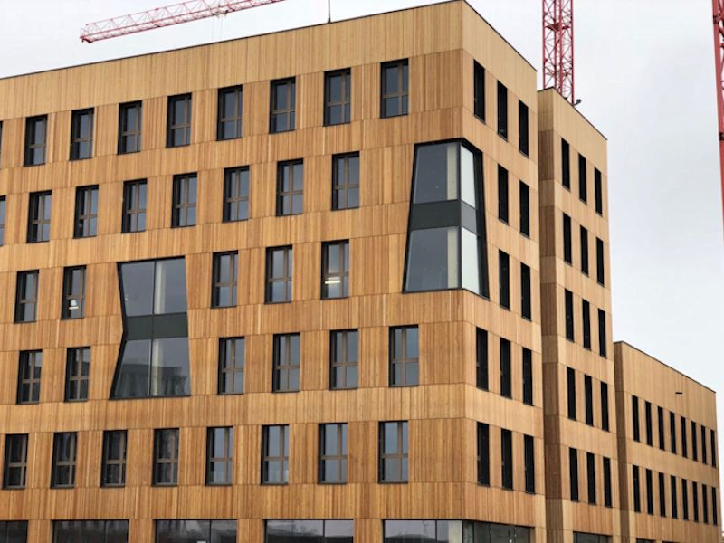
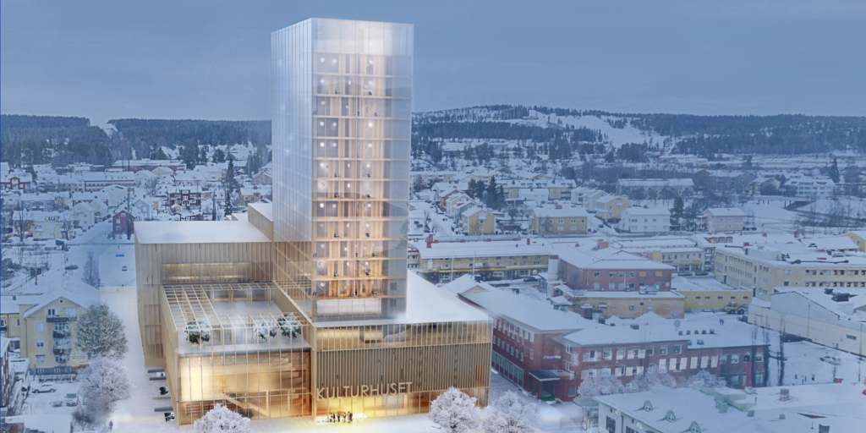
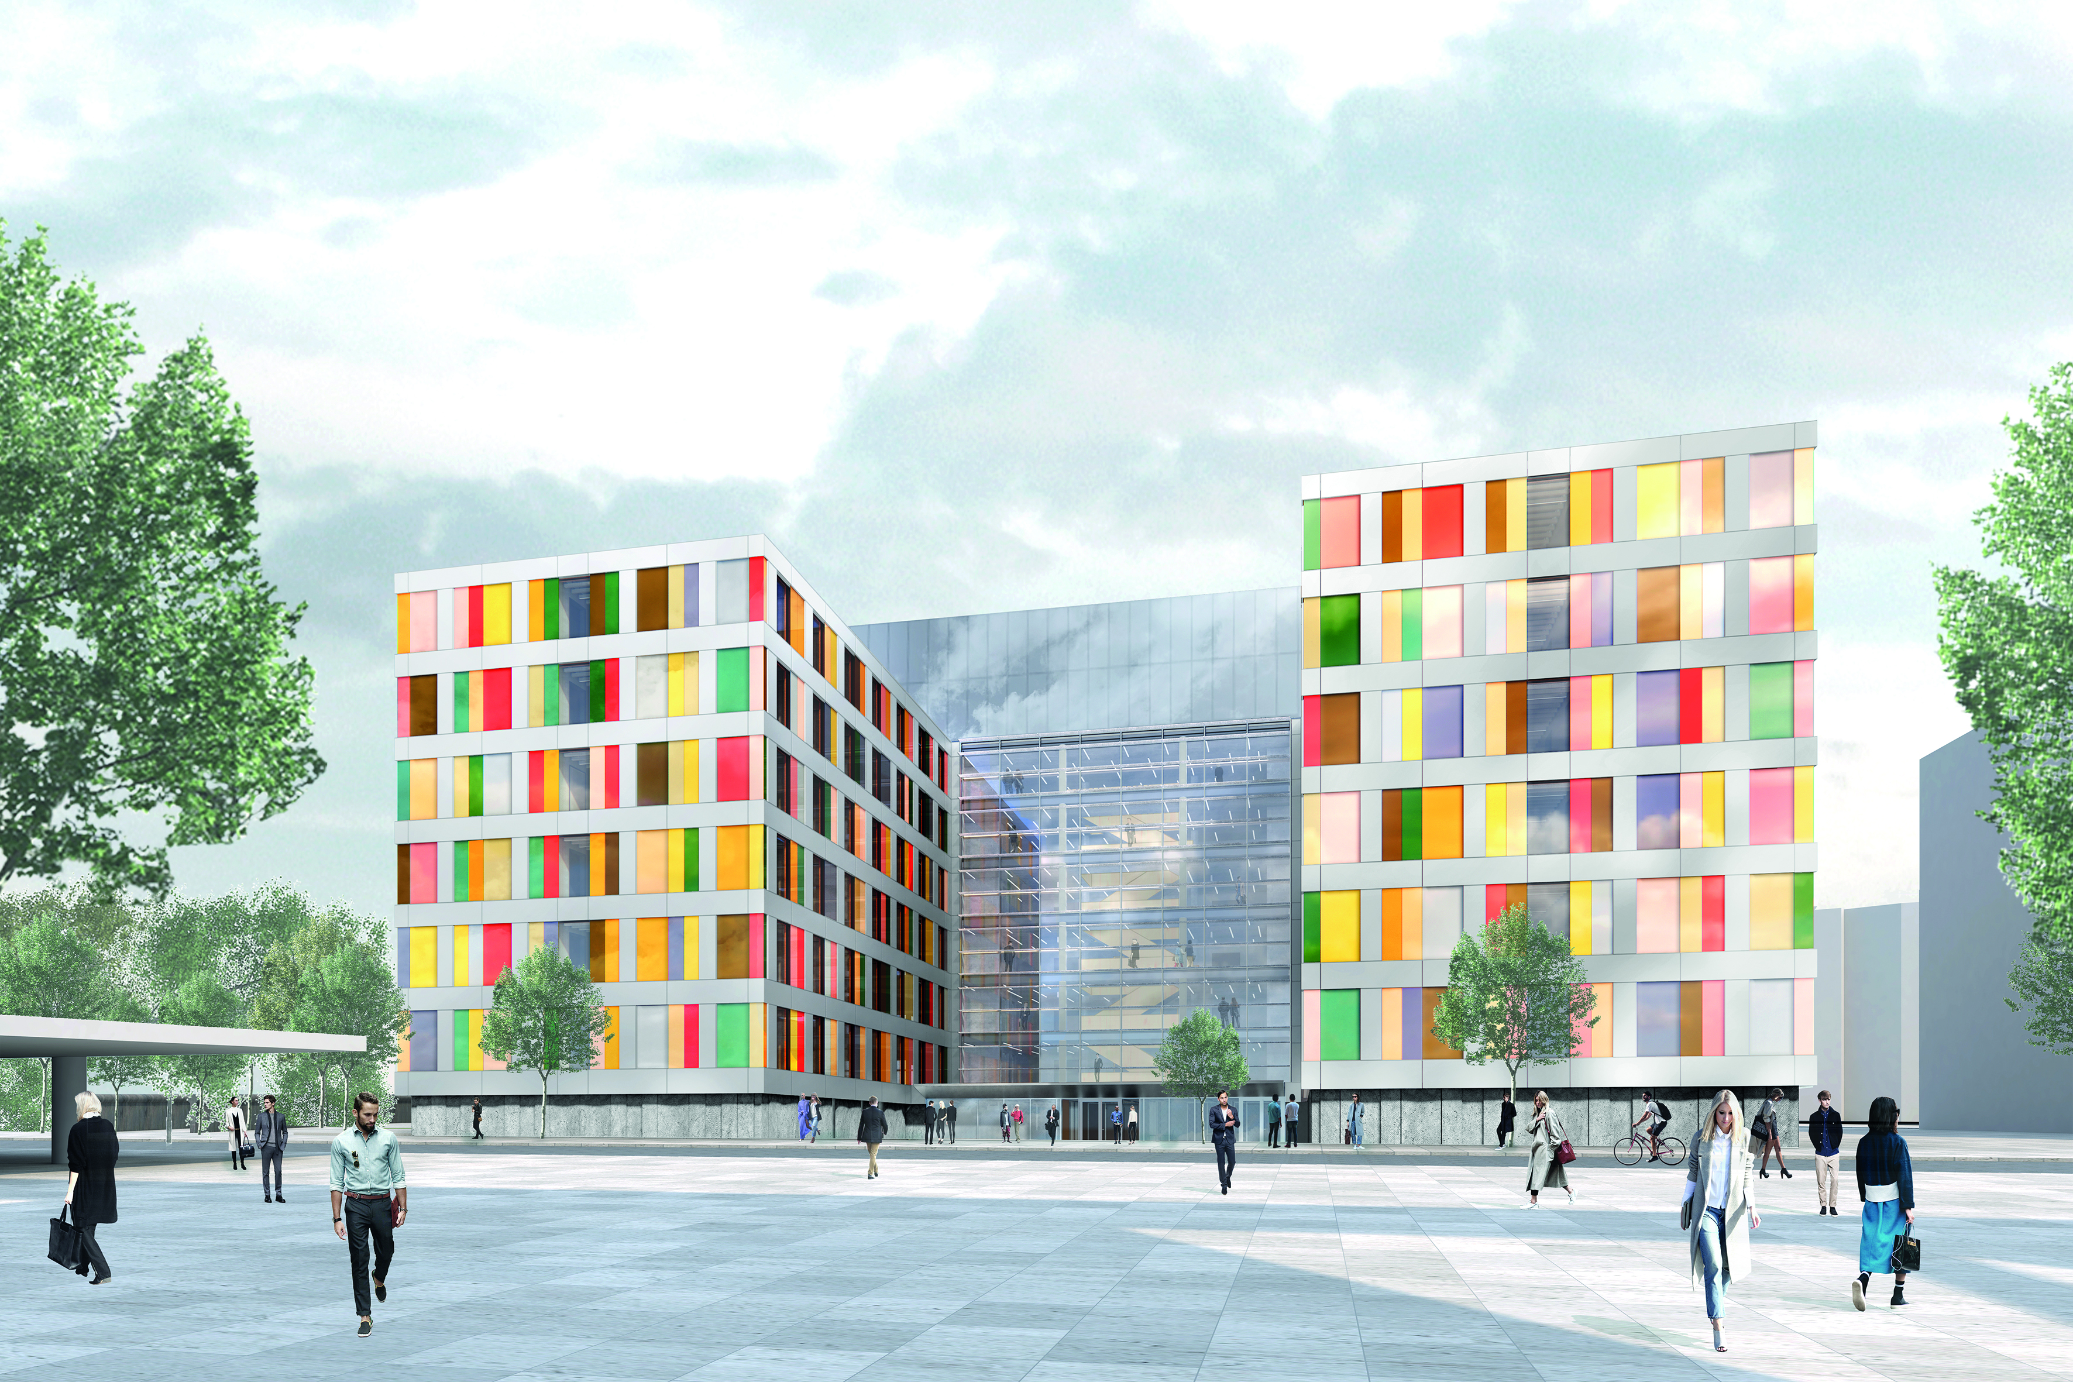

Slide 10
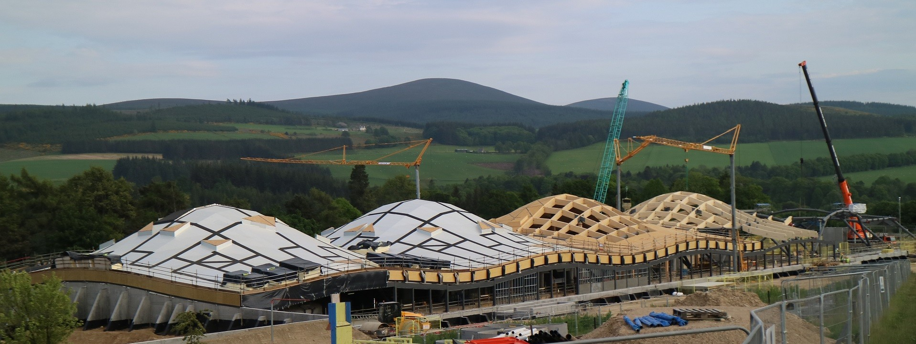
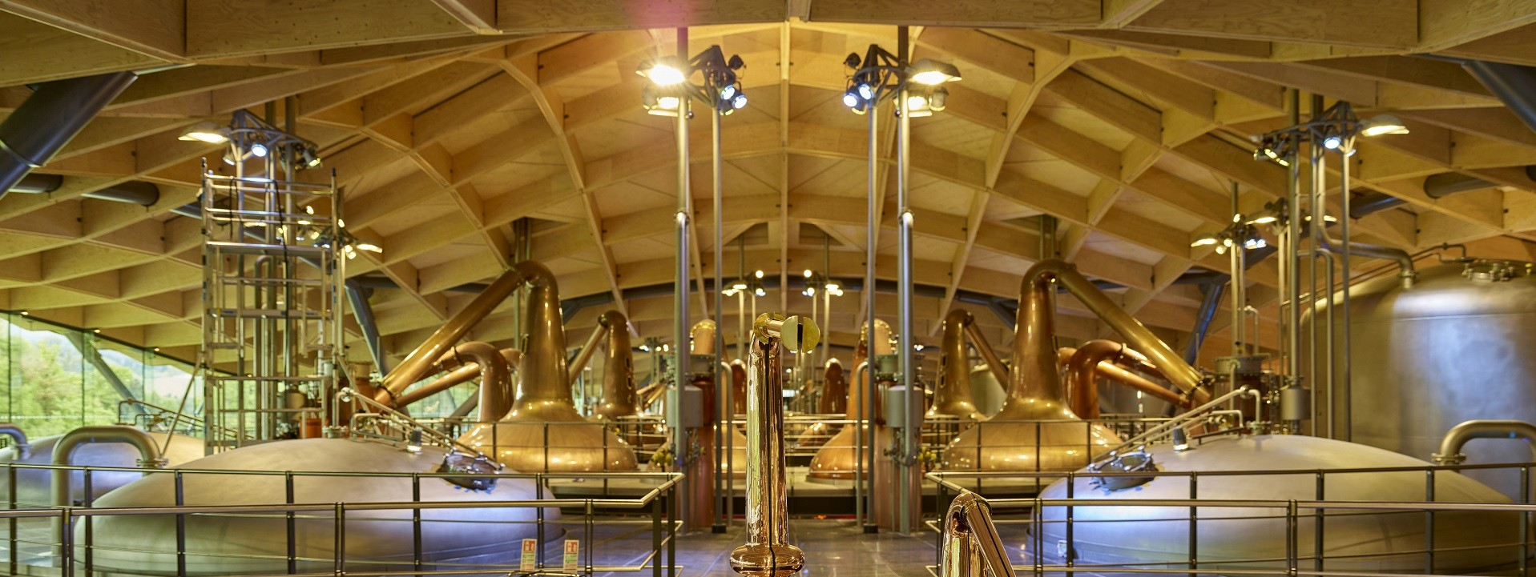
Notes:
Best example of what is possible closest to the COP?

Slide 11
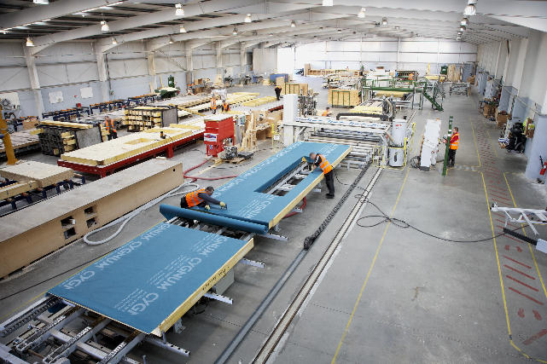
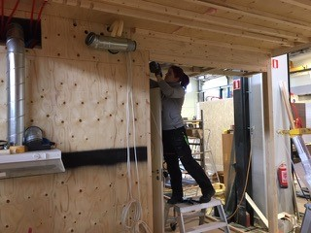
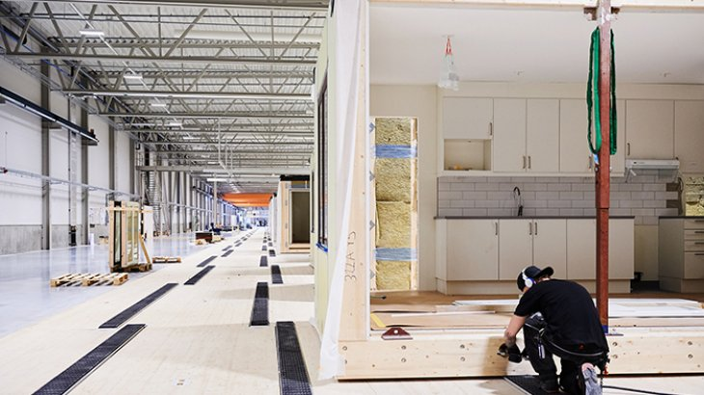
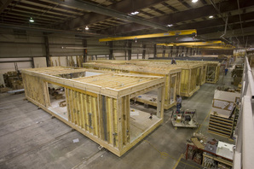
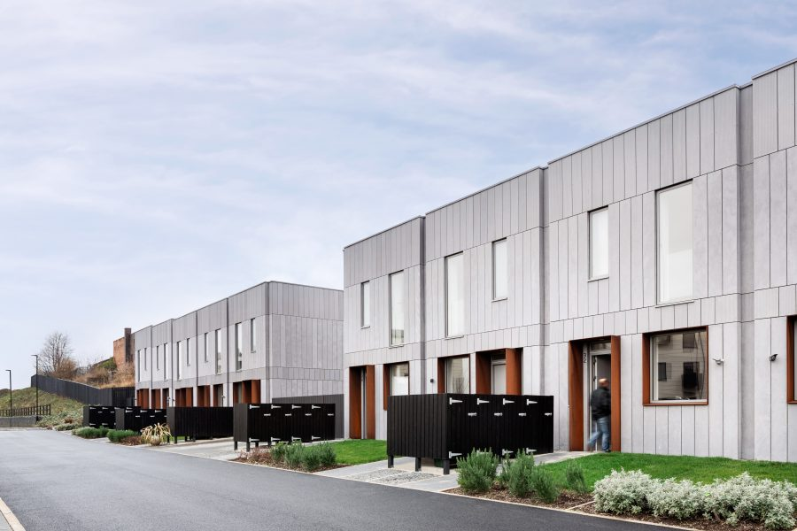
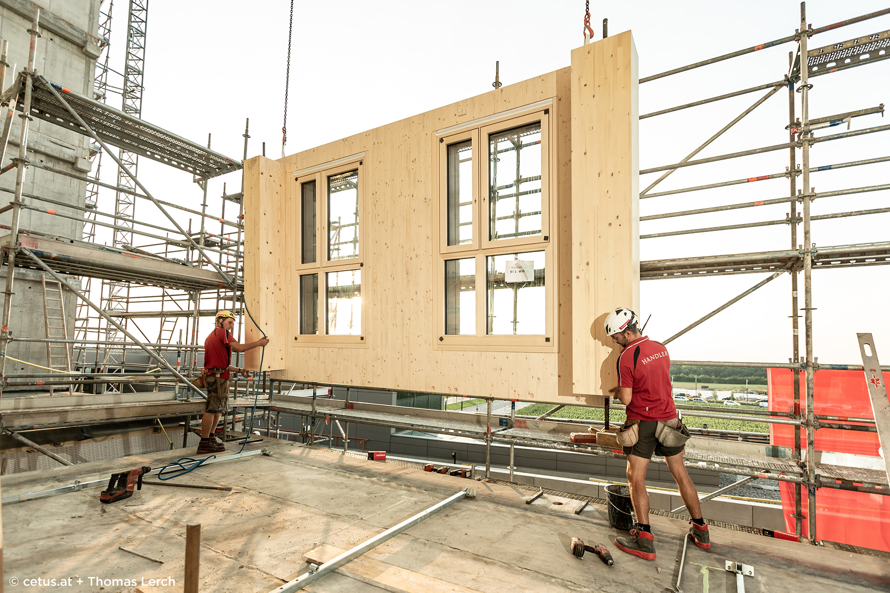

Slide 12
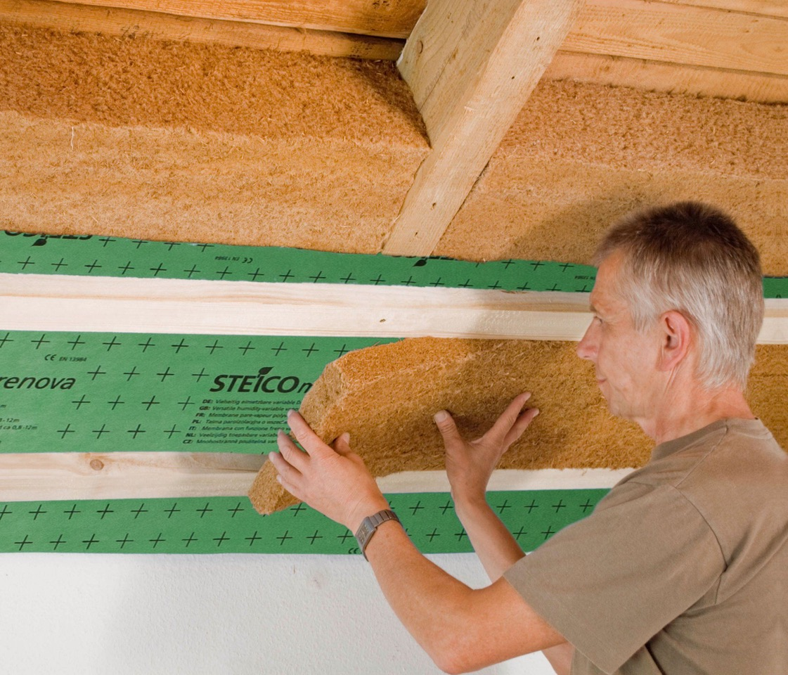
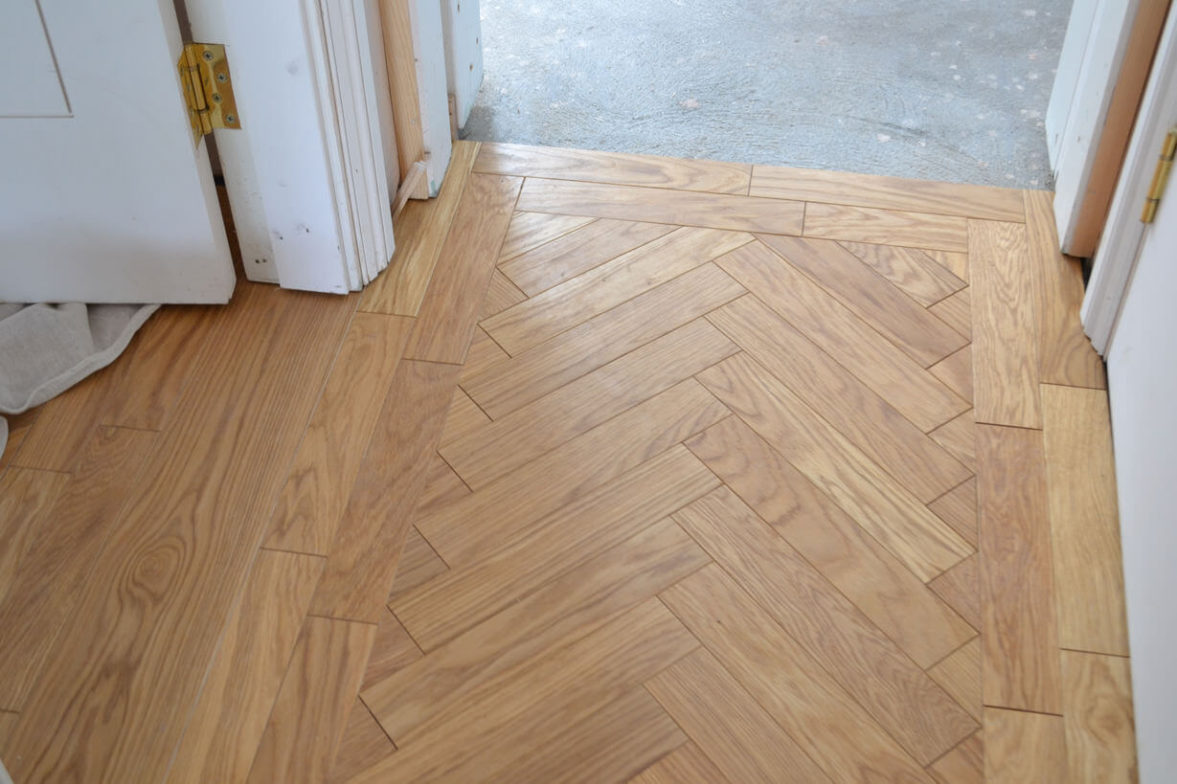
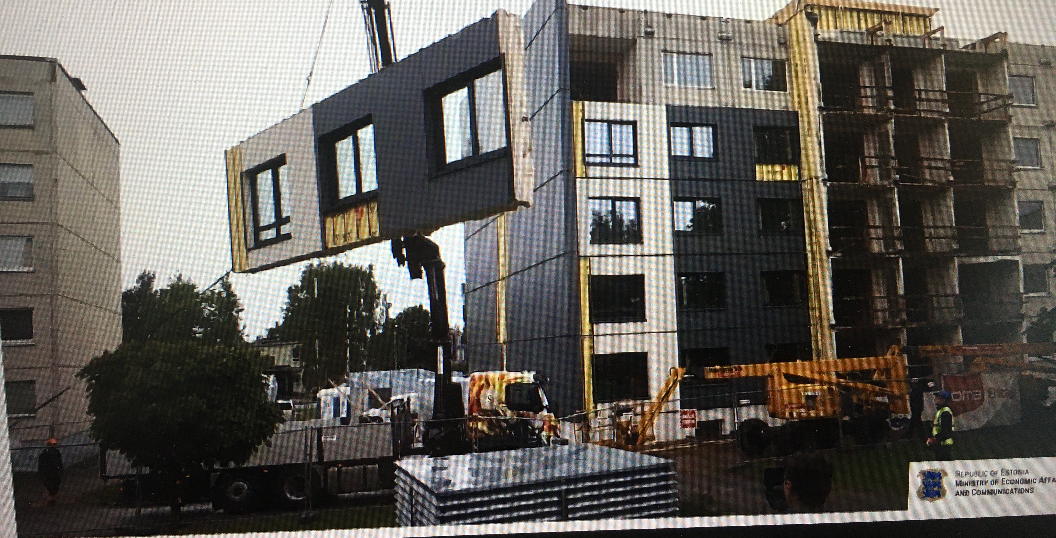
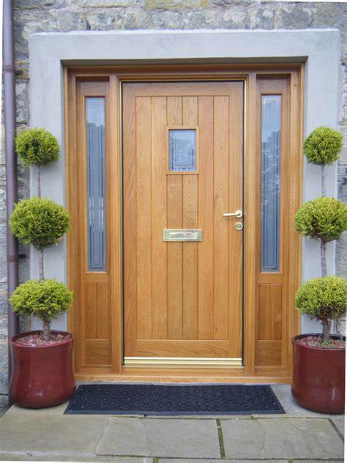

Slide 13
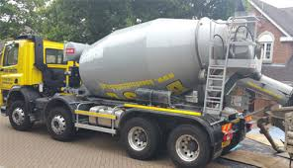
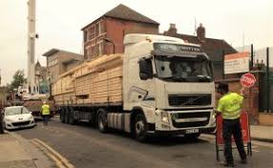
Notes:
Win – win …. Improve air quality AND reduce carbon emissions

Slide 14
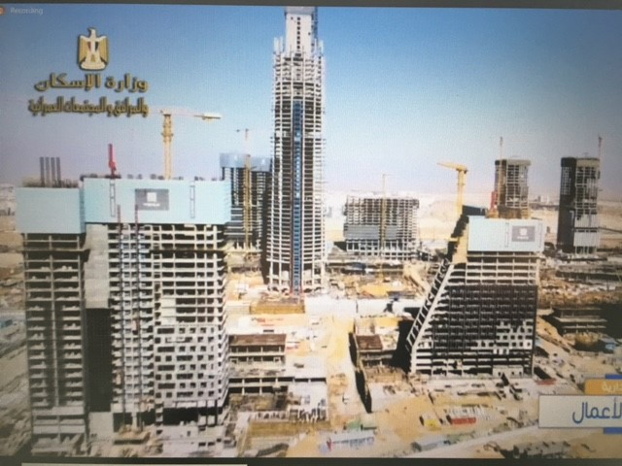

Slide 15
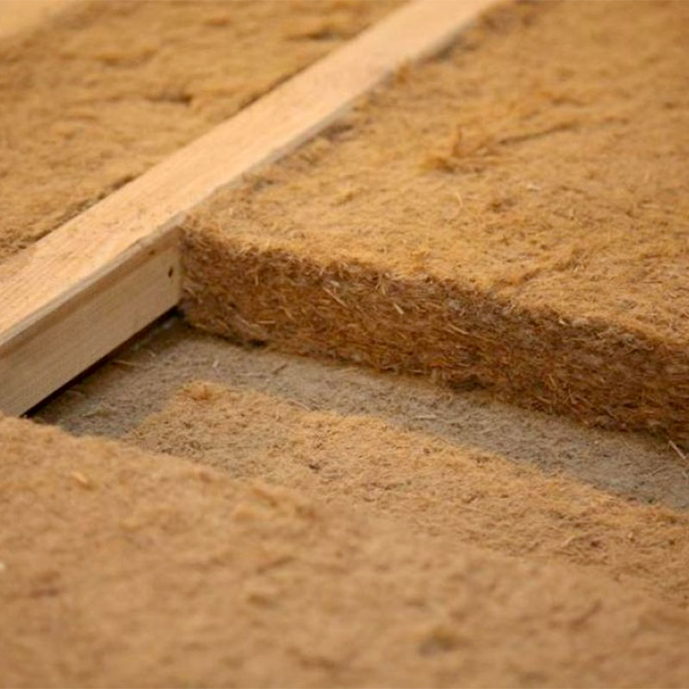
Renovate and Build

Slide 16
Woods total built environment contribution to tackling climate change
Sequestered in the forest A Historically stored in the built environment B
Potential to store in new build C
Potential to store in renovation D
Substituting for carbon intensive materials E
Potential & historic store in wooden furniture F
_______________
Total A+B+C+D+E+F

Slide 17
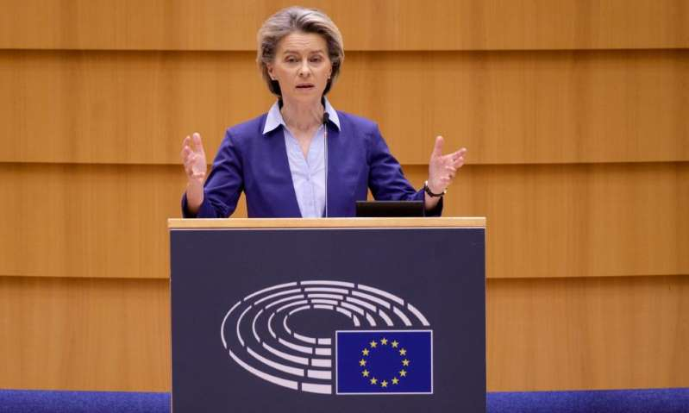
“We know that the construction sector can be turned from a carbon source into a carbon sink, if organic building materials like wood … are applied”

Slide 18
COLLECTIVE OBJECTIVE
The timber and forest sector has a key role to play in the transition towards a greener and more sustainable economy mainly through the abatement of greenhouse gas emissions. The sector could play a still more significant role if governments and others seize the opportunity to decarbonise construction by using wood-based products for green construction, renovation and furniture wherever appropriate and possible.

Slide 19
COLLECTIVE OBJECTIVE cont.
Our objective in attending COP26 is to communicate the significant role our sector can play in tacking climate change. We will call for governments to have long-term visions that enable a real shift towards a green economy via the use of wood in mitigating climate change including the positive role that the timber supply chain plays in managing, maintaining and extending forest cover.

Slide 20
STEERING GROUP
CEI-Bois – Paul Brannen, Director Public Affairs - Chair
Wood for Good – Sarah Virgo
Confor – Andy Leitch
TTF – Dave Hopkins & Lucy Kamall
US Soft Wood Lumber Board – Nick Milestone
Forest Products Association of Canada – Derek Nighbor
Assolegno – Marco Luchetti. (Italy)
Note: Italian Government are the COP co-hosts.

Slide 21
INTERNATIONAL PARTNERS ADVISORY GROUP
European Panel Federation – Clive Pinnington
Structural Timber Association – Andrew Carpenter
European Timber Trade Federation – Thomas Goebel
American Hardwood Export Council – David Venables & Rupert Oliver
Swedish Wood – Mathias Fridholm
Finnish Forest Industries – Karoliina Niemi
ProHolz – Georg Binder
European Forest Institute – Harald Mauser
Henrik Valja - Estonian wood working association
Ross Hampton, CEO of Australian Forest Products Association & Richard Hyett, Climate Adviser
David Rhodes, CEO, New Zealand Forest Owners Association

Slide 22
PAVILLION

Slide 23
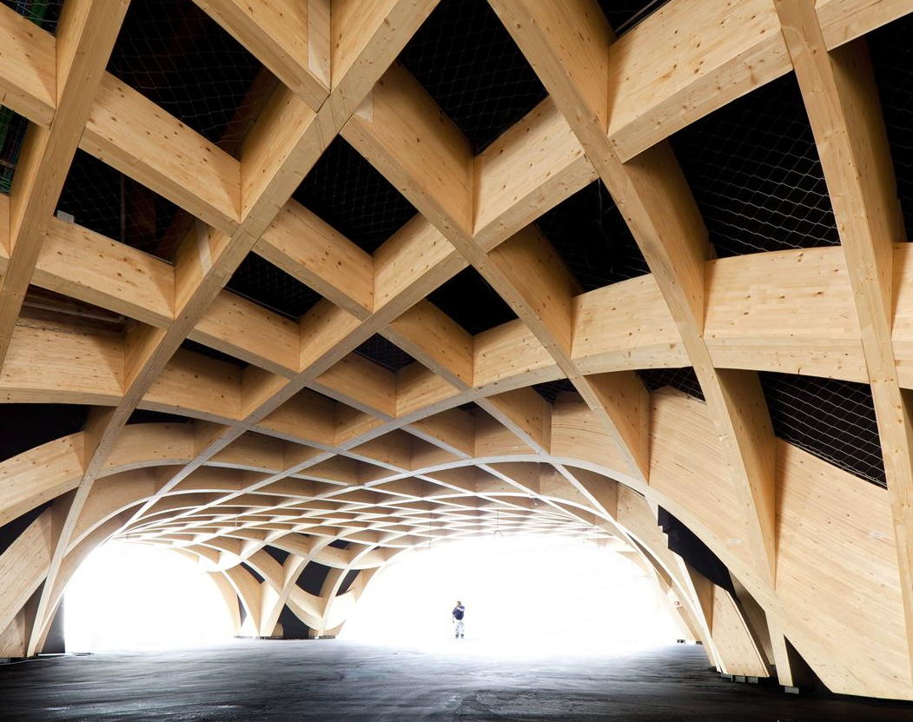
PAVILLION

Slide 24
QUESTIONS - DISCUSSION

